Slide 1
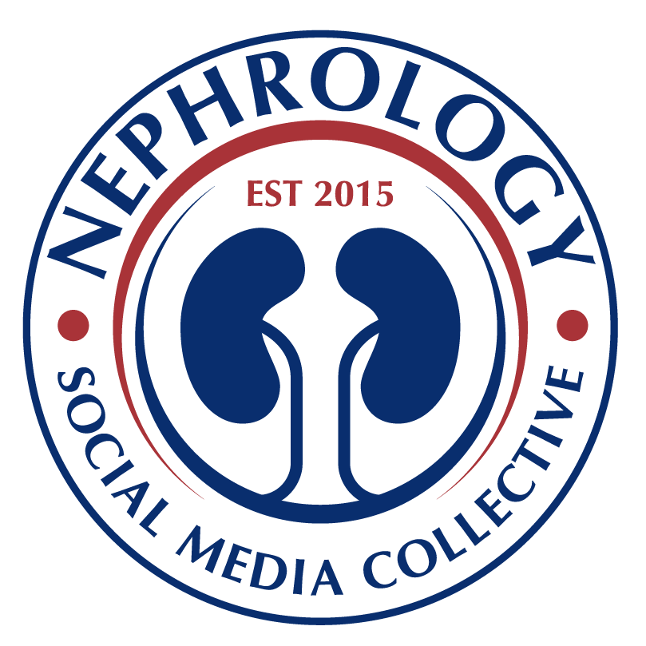
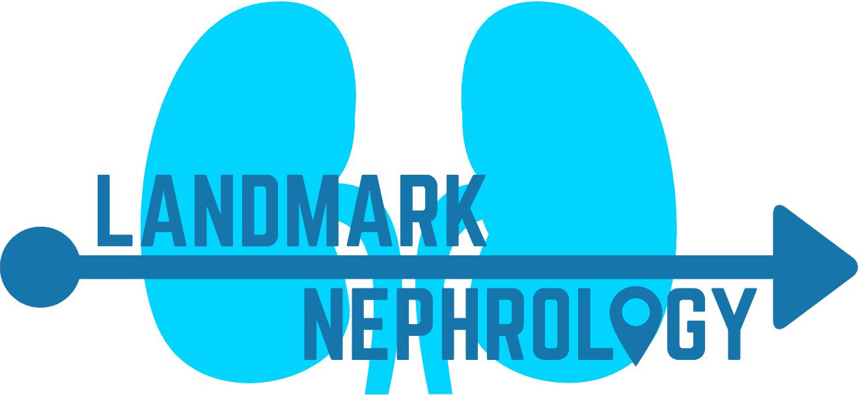
Landmark Studies in Induction Immunosuppression
in Kidney Transplantation
Thiabudin et. al.
Anti-thymocyte globulin vs Placebo
Lowered incidence of biopsy-proven acute rejection episodes and increased 1 year graft survival.
Goggins et al.
Intra- vs Post-operative ATG
Intraoperative thymoglobulin showed decreased delayed graft function.
Brennan et al.
Rabbit ATG vs Basiliximab
The use of rabbit ATG led to lower rejection with slightly worse infections compared to Basliximab in patients at high risk for rejection. Both groups had similar graft loss and delayed graft function.
Noel et al.
Thymoglobulin vs daclizumab
Thymoglobulin patients had lower incidence of biopsy proven acute and steroid-resistance rejection in 1 year. Otherwise, similar graft and patient survival.
Hanaway et al.
The INTAC study
Using Alemtuzumab in high-risk patients vs conventional therapy led to significantly lower rejection rates at 6 and 12 months, but did show higher late rejection rates, incidence of cancer-related adverse events & infections.
Kucirka et al.
Induction in HIV
Use of induction therapy was associated with lower rates of delayed graft function, lower infection, graft loss & lower mortality in HIV patients. ATG induction was better than IL2RA in rejection rates.
1998
2002
2006
2009
2011
2016
1999
2005
2008
2010
2015
2017
Brennan et al.
Thymoglobulin vs ATGAM
Rabbit anti-thymocyte globulin (thymoglobulin) patients had fewer rejection rates and adverse events vs equine antithymocyte globulin (ATGAM).
Kaufman et al.
Alemtuzumab vs Basiliximab induction
Alemtuzumab induction was similar to Basiliximab in efficacy in steroid-free maintenance protocol
Gurk-Turner et. al.
Thymoglobulin dose optimization
Evaluated the effect of total rabbit ATG on graft outcomes. There was no difference in graft survival of groups with > or <7.5 mg/kg.
Cochrane Review:IL-2
Receptor α(IL2RA)
IL2RA reduced acute rejection vs placebo. No change in graft loss/rejection vs. ATG recipients. ATG patienTS had 75% increase in malignancy + 32% increase in CMV disease vs. IL2RA recipients.
Saull et al.
Alemtuzumab vs ATG with steroid withdrawal
One-year acute rejection rates were similar between the alemtuzumab and ATG groups; however, rejection Banff IA and higher was more common in the alemtuzumab arm.
Hill et al
Webster et al
Cochrane Review:
Poly/monoclonal Ab
ATG reduced acute graft rejection by 37% , has uncertain effects on death, graft survival, malignancy, new onset diabetes. ATG & Alemtuzumab decrease rejection at cost of increased CMV infections.

