Slide 1
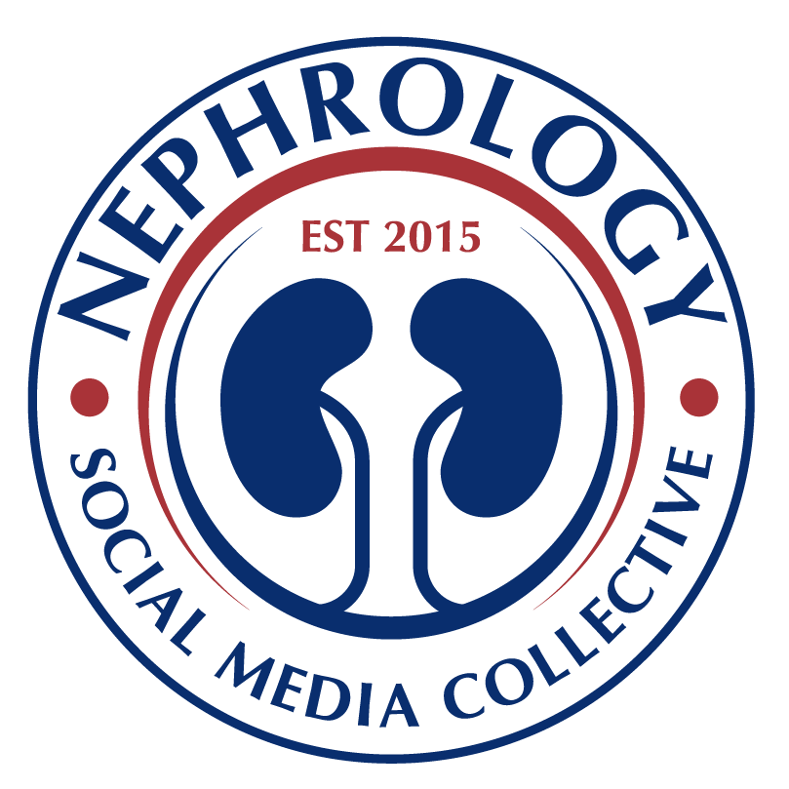
Landmark studies in Maintenance Immunosuppression
in Kidney Transplantation
Ekberg et al
CAESAR study
Calcineurin inhibitors (CNI) withdrawal
Low-dose and standard cyclosporine (CsA) showed similar glomerular filtration rate (GFR) rates and lower biopsy-proven acute rejection (BPAR) compared to CSA withdrawal group.
Gaston et al
OPTICEPT trial
MMF and CNI-sparing
Mycophenolate mofetil (MMF) in reduced CNI regimens resulted not inferior, low BPAR rates, and higher adverse events compared to standard therapy.
Weir MR et al
Spare-the-Nephron
SRL based vs MMF/ CNI regimen
A 2-year regimen of MMF/CNI compared to MMF/SRL treatment resulted in similar measures of renal function but with fewer deaths and a trend to less BPAR and graft loss.
Flechner et al
ORION study
Two SRL-based regimens vs TAC/ MMF
The SRL-based regimens showed similar estimated GFR (eGFR), higher BCAR rates at one year follow up, delayed wound healing and hyperlipidemia.
de Fijter et al
ELEVATE Trial
EVR conversion vs CNI therapy
EVR conversion showed no difference in eGFR after 1 year. However, higher BPAR rates compared to TAC group. .
2007
2009
2011
2012
2017
2007
2009
2011
2014
2019
Ekberg et al
ELITE SYMPHONY
Reduced exposure to CNI
Low-dose tacrolimus (TAC) patients had higher GFR, lower BPAR and increased allograft survival rates compared to other groups.
Schena et al
CONVERT trial
Conversion from CNI to SRL
In selected cases, sirolimus (SRL) conversion had excellent patient and graft survival and no difference in biopsy-confirmed acute rejection (BCAR) compared with CNI.
Budden et al
ZEUS study
Everolimus (EVR)-based with CNI withdrawal
CSA withdrawal to undergo EVR-based regimen improved GFR with higher BPAR, slightly increased urinary protein excretion, and lower hemoglobin concentrations.
Chadban et al
SOCRATES
EVR after steroid or CSA withdrawal
Noninferiority in eGFR, but higher trend towards composite treatment failure (BPAR, graft loss, death, loss to follow-up).
de Fijter et al
TRANSFORM study
EVR with reduced CNI therapy noninferiority study
EVR + rCNI was non inferior in eGFR and BPAR endpoints. Also, de novo DSA and viral infections were lower compared to standard regimen after 24 months follow up.
Notes:
2007, Ekberg et al
CAESAR study
Low-dose and standard CsA regimen showed similar GFR rates and lower BPAR compared to CSA withdrawal group.
2. 2007, Ekberg et al
ELITE SYMPHONY
Reduced exposure to CNI
Low-dose TAC patients had higher GFR, lower BPAR and higher allograft survival rates compared to daclizumab plus low-dose CSA or low-dose SRL or with standard-dose CSA without induction.
3. 2009, Gaston et al
OPTICEPT trial
MMF in CNI-sparing regimens
MMF in reduced CNI regimens resulted not inferior, low BPAR rates, and higher adverse events compared to standard therapy.
4. 2009 Schena et al
CONVERT trial
Conversion from CNI to SRL
In patients with GFR above 40 mL/min and SRL conversion had excellent patient and graft survival, no difference in BCAR, increased urinary protein excretion, and a lower incidence of malignancy compared with CNI continuation.
5. 2010 Vincenti et al
BENEFIT study
Belatacept‐based regimens vs CSA
Belatacept had superior renal function and similar patient/graft survival vs CSA at 1 year posttransplant, despite a higher rate of acute rejection episodes and lymphoproliferative disorder.
6. 2010 Durrbach et al
BENEFIT-EXT study
Belatacept vs CSA in extended criteria donors
Belatacept ECD patients achieved similar survival rates, higher eGFR, increased incidence of PTLD, and improvement on CV risk profile vs CSA/treated patients.
7. 2011 Weir MR et al
Spare-the-Nephron trial
Sirolimus based vs MMF/ CNI regimen
A 2-year regimen of MMF/CNI compared to MMF/SRL treatment resulted in similar measures of renal function but with fewer deaths and a trend to less BPAR and graft loss.
8. 2011 Budden et al
ZEUS study
Everolimus-based with CNI free regimen
Early elimination of ciclosporin to undergo everolimus based regimen improved renal function at 12 months while maintaining efficacy and safety, indicating that this strategy may facilitate improved long-term outcomes in selected patients.
9. 2012 Flechner et al
ORION study
Two Sirolimus-based regimens vs TAC/ MMF regimen
The SRL-based regimens showed similar eGFR, higher BCAR rates at one year follow up, delayed wound healing and hyperlipidemia.
10. 2014 Chadban et al
SOCRATES
Everolimus after steroid or CSA withdrawal
Noninferiority in eGFR, but higher trend towards composite treatment failure (BPAR, graft loss, death, loss to follow-up).
11. 2017 de Fijter et al
ELEVATE Trial
Everolimus conversion vs CNI therapy
Conversion to EVR at 10-14 weeks posttransplant was associated with similar eGFR at month 12 with standard therapy overall. However, more frequent BPAR under EVR CNI overall, and higher rates of discontinuation due to adverse events.
12. 2019 Berger et al
TRANSFORM study
Everolimus with reduced CNI therapy noninferiority study
EVR + rCNI regimen offers comparable efficacy and graft function with low tBPAR and dnDSA rates and significantly lower incidence of viral infections relative to standard-of-care up to 24 months
2019 Sommerer et al
Everolimus with reduced CNI therapy noninferiority study
ATHENA study
EVR + CNI showed comparable efficacy to MPA/TAC in de novo kidney transplant patients. Non-inferiority of renal function and lower infection rates when comparable to MPA/TAC.

Slide 2
Landmark studies in Maintenance Immunosuppression
in Kidney Transplantation
Ekberg et al
CAESAR study
Calcineurin inhibitors (CNI) withdrawal
Low-dose and standard cyclosporine (CsA) showed similar glomerular filtration rate (GFR) rates and lower biopsy-proven acute rejection (BPAR) compared to CSA withdrawal group.
Gaston et al
OPTICEPT trial
MMF and CNI-sparing
Mycophenolate mofetil (MMF) in reduced CNI regimens resulted not inferior, low BPAR rates, and higher adverse events compared to standard therapy.
Vincenti et al
BENEFIT study
Belatacept regimens vs CSA
Belatacept had superior renal function & similar patient/graft survival vs CSA at 1 year, despite a higher rate of acute rejection episodes & post-transplant lymphoproliferative disorders (PTLD).
Weir MR et al
Spare-the-Nephron
SRL based vs MMF/ CNI regimen
A 2-year regimen of MMF/CNI compared to MMF/SRL treatment resulted in similar measures of renal function but with fewer deaths and a trend to less BPAR and graft loss.
Flechner et al
ORION study
Two SRL-based regimens vs TAC/ MMF
The SRL-based regimens showed similar estimated GFR (eGFR), higher BCAR rates at one year follow up, delayed wound healing and hyperlipidemia.
de Fijter et al
ELEVATE Trial
EVR conversion vs CNI therapy
EVR conversion showed no difference in eGFR after 1 year. However, higher BPAR rates compared to TAC group. .
2007
2009
2010
2011
2012
2017
2007
2009
2010
2011
2014
2019
Ekberg et al
ELITE SYMPHONY
Reduced exposure to CNI
Low-dose tacrolimus (TAC) patients had higher GFR, lower BPAR and increased allograft survival rates compared to other groups.
Schena et al
CONVERT trial
Conversion from CNI to SRL
In selected cases, sirolimus (SRL) conversion had excellent patient and graft survival and no difference in biopsy-confirmed acute rejection (BCAR) compared with CNI.
Durrbach et al
BENEFIT-EXT study
Belatacept vs CSA in extended criteria donors
Belatacept ECD patients achieved similar survival rates, higher estimated GFR (eGFR), increased incidence of PTLD, and improvement on cardiovascular risk profile vs CSA/treated patients.
Budden et al
ZEUS study
Everolimus (EVR)-based with CNI withdrawal
CSA withdrawal to undergo EVR-based regimen improved GFR with higher BPAR, slightly increased urinary protein excretion, and lower hemoglobin concentrations.
Chadban et al
SOCRATES
EVR after steroid or CSA withdrawal
Noninferiority in eGFR, but higher trend towards composite treatment failure (BPAR, graft loss, death, loss to follow-up).
de Fijter et al
TRANSFORM study
EVR with reduced CNI therapy noninferiority study
EVR + rCNI was non inferior in eGFR and BPAR endpoints. Also, de novo DSA and viral infections were lower compared to standard regimen after 24 months follow up.
Notes:
2007, Ekberg et al
CAESAR study
Low-dose and standard CsA regimen showed similar GFR rates and lower BPAR compared to CSA withdrawal group.
2. 2007, Ekberg et al
ELITE SYMPHONY
Reduced exposure to CNI
Low-dose TAC patients had higher GFR, lower BPAR and higher allograft survival rates compared to daclizumab plus low-dose CSA or low-dose SRL or with standard-dose CSA without induction.
3. 2009, Gaston et al
OPTICEPT trial
MMF in CNI-sparing regimens
MMF in reduced CNI regimens resulted not inferior, low BPAR rates, and higher adverse events compared to standard therapy.
4. 2009 Schena et al
CONVERT trial
Conversion from CNI to SRL
In patients with GFR above 40 mL/min and SRL conversion had excellent patient and graft survival, no difference in BCAR, increased urinary protein excretion, and a lower incidence of malignancy compared with CNI continuation.
5. 2010 Vincenti et al
BENEFIT study
Belatacept‐based regimens vs CSA
Belatacept had superior renal function and similar patient/graft survival vs CSA at 1 year posttransplant, despite a higher rate of acute rejection episodes and lymphoproliferative disorder.
6. 2010 Durrbach et al
BENEFIT-EXT study
Belatacept vs CSA in extended criteria donors
Belatacept ECD patients achieved similar survival rates, higher eGFR, increased incidence of PTLD, and improvement on CV risk profile vs CSA/treated patients.
7. 2011 Weir MR et al
Spare-the-Nephron trial
Sirolimus based vs MMF/ CNI regimen
A 2-year regimen of MMF/CNI compared to MMF/SRL treatment resulted in similar measures of renal function but with fewer deaths and a trend to less BPAR and graft loss.
8. 2011 Budden et al
ZEUS study
Everolimus-based with CNI free regimen
Early elimination of ciclosporin to undergo everolimus based regimen improved renal function at 12 months while maintaining efficacy and safety, indicating that this strategy may facilitate improved long-term outcomes in selected patients.
9. 2012 Flechner et al
ORION study
Two Sirolimus-based regimens vs TAC/ MMF regimen
The SRL-based regimens showed similar eGFR, higher BCAR rates at one year follow up, delayed wound healing and hyperlipidemia.
10. 2014 Chadban et al
SOCRATES
Everolimus after steroid or CSA withdrawal
Noninferiority in eGFR, but higher trend towards composite treatment failure (BPAR, graft loss, death, loss to follow-up).
11. 2017 de Fijter et al
ELEVATE Trial
Everolimus conversion vs CNI therapy
Conversion to EVR at 10-14 weeks posttransplant was associated with similar eGFR at month 12 with standard therapy overall. However, more frequent BPAR under EVR CNI overall, and higher rates of discontinuation due to adverse events.
12. 2019 Berger et al
TRANSFORM study
Everolimus with reduced CNI therapy noninferiority study
EVR + rCNI regimen offers comparable efficacy and graft function with low tBPAR and dnDSA rates and significantly lower incidence of viral infections relative to standard-of-care up to 24 months
2019 Sommerer et al
Everolimus with reduced CNI therapy noninferiority study
ATHENA study
EVR + CNI showed comparable efficacy to MPA/TAC in de novo kidney transplant patients. Non-inferiority of renal function and lower infection rates when comparable to MPA/TAC.

